Slide 1
Randomized Block Designs
Larry V. Hedges
Northwestern University
Presented at the NSF Institute on Improving the Design of Evaluation studies in STEM Education Research, July 20, 2021

Slide 2
What is a Randomized Block Design?
In the most abstract sense, a randomized block design is one that assigns individuals to treatments not overall but within pre-existing groups (called blocks in the experimental design literature)
Sample
Block 1
Block 2
Block m
Intervention
Comparison
Intervention
Comparison
Intervention
Comparison

Slide 3
What is a Randomized Block Design?
Randomized block designs are also called multisite designs because the blocks are often geographical or organizational sites (like classrooms or schools)
The individuals within blocks are implicitly matched on everything blocks have in common
Often these designs arise because of multi-stage sampling: Individuals are nested within sites or statistical clusters (hence the name multisite design)
For example: You need to go to several schools in order to obtain the required sample size, so you randomly assign individuals to treatments within schools
In a balanced design, the same number n of individuals will be assigned to each treatment within each site or block, for a total of 2n individuals per site or block, with m sites or blocks, and a total sample size of N = 2mn

Slide 4
How is this Design Different from the Individually Randomized Design?
Suppose the sample comes from five schools
In the individually randomized design, you would make a list of all participants and randomize participants into treatments regardless of which school they were in—you might wind up with different numbers of treatment or control participants in different schools
In a randomized block design, you would make up a list of participants in each school and carry out a separate randomization within each schools separately
This doesn’t sound like much of a difference, but it can make a huge difference in design sensitivity
Why?
Because participants are matched within blocks, differences between blocks do not contribute toe experimental error (noise)

Slide 5
Examples Slides

Slide 7
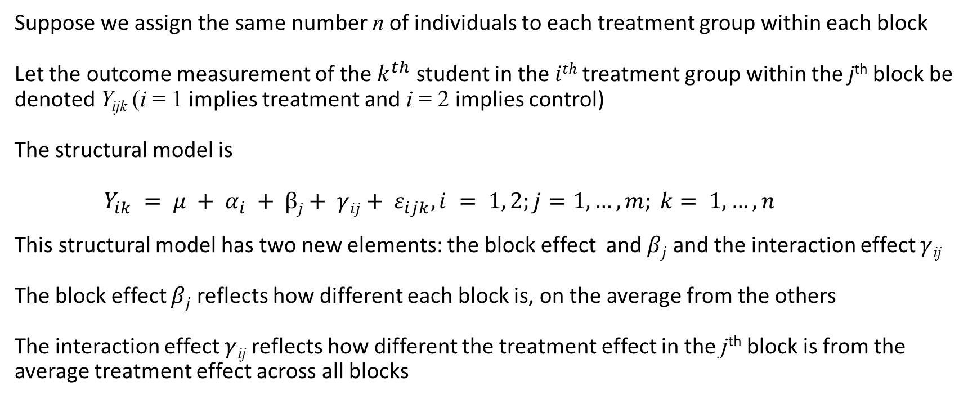
A Statistical Model
Suppose we assign the same number n of individuals to each treatment group within each block
Let the outcome measurement of the $k^{th}$ student in the $ith$treatment group within the j^{th} block be denoted Y_{ijk} (i = 1 implies treatment and i = 2 implies control)
The structural model is
$Y_{ik} = μ + α_{i} + βj+ γ{ij+ ε}_{ijk}, i = 1, 2;j=1, …, m; k= 1, …, n$
This structural model has two new elements: the block effect and $βj$ and the interaction effect $γ$_{ij}
The block effect $βj$ reflects how different each block is, on the average from the others
The interaction effect $γ$_{ij} reflects how different the treatment effect in the j^{th} block is from the average treatment effect across all blocks

Slide 8
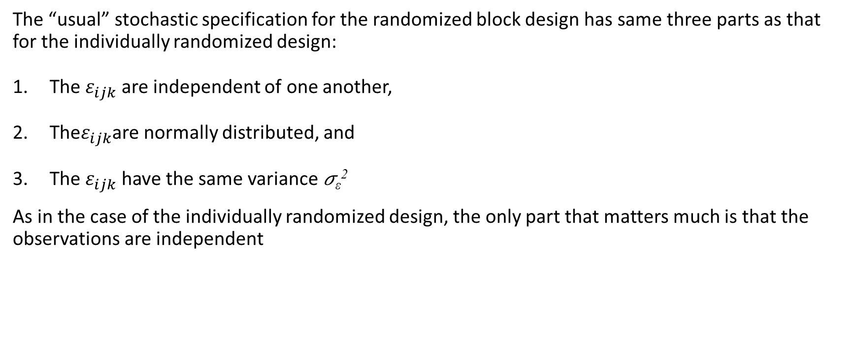
A Statistical Model
The “usual” stochastic specification for the randomized block design has same three parts as that for the individually randomized design:
The $ε_{ijk}$ are independent of one another,
The$ε_{ijk}$are normally distributed, and
The $ε_{ijk}$have the same variance 𝜎_{ε}²
As in the case of the individually randomized design, the only part that matters much is that the observations are independent

Slide 9
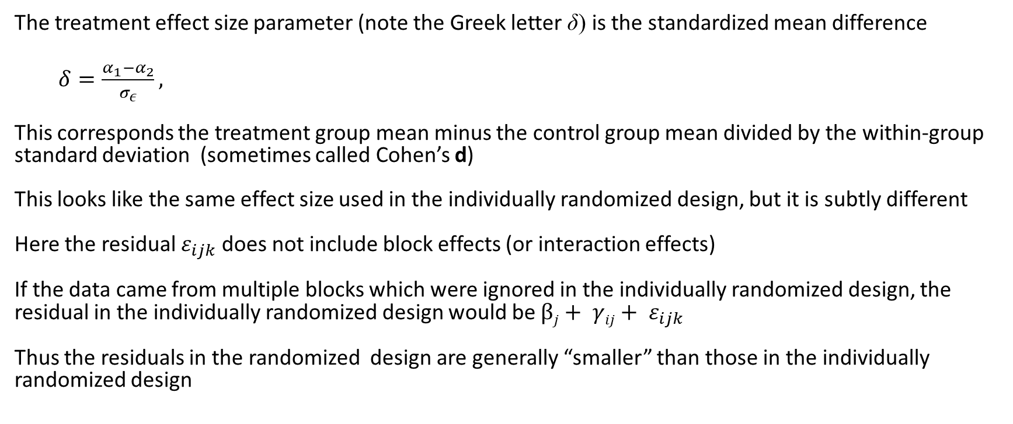
Effect Size
The treatment effect size parameter (note the Greek letter δ) is the standardized mean difference
$δ=\frac{α_{1}−α_{2}}{σ_{ε}},$
This corresponds the treatment group mean minus the control group mean divided by the within-group standard deviation (sometimes called Cohen’s d)
This looks like the same effect size used in the individually randomized design, but it is subtly different
Here the residual $ε_{ijk}$ does not include block effects (or interaction effects)
If the data came from multiple blocks which were ignored in the individually randomized design, the residual in the individually randomized design would be $βj+ γ{ij+ ε}_{ijk}$
Thus the residuals in the randomized design are generally “smaller” than those in the individually randomized design

Slide 10
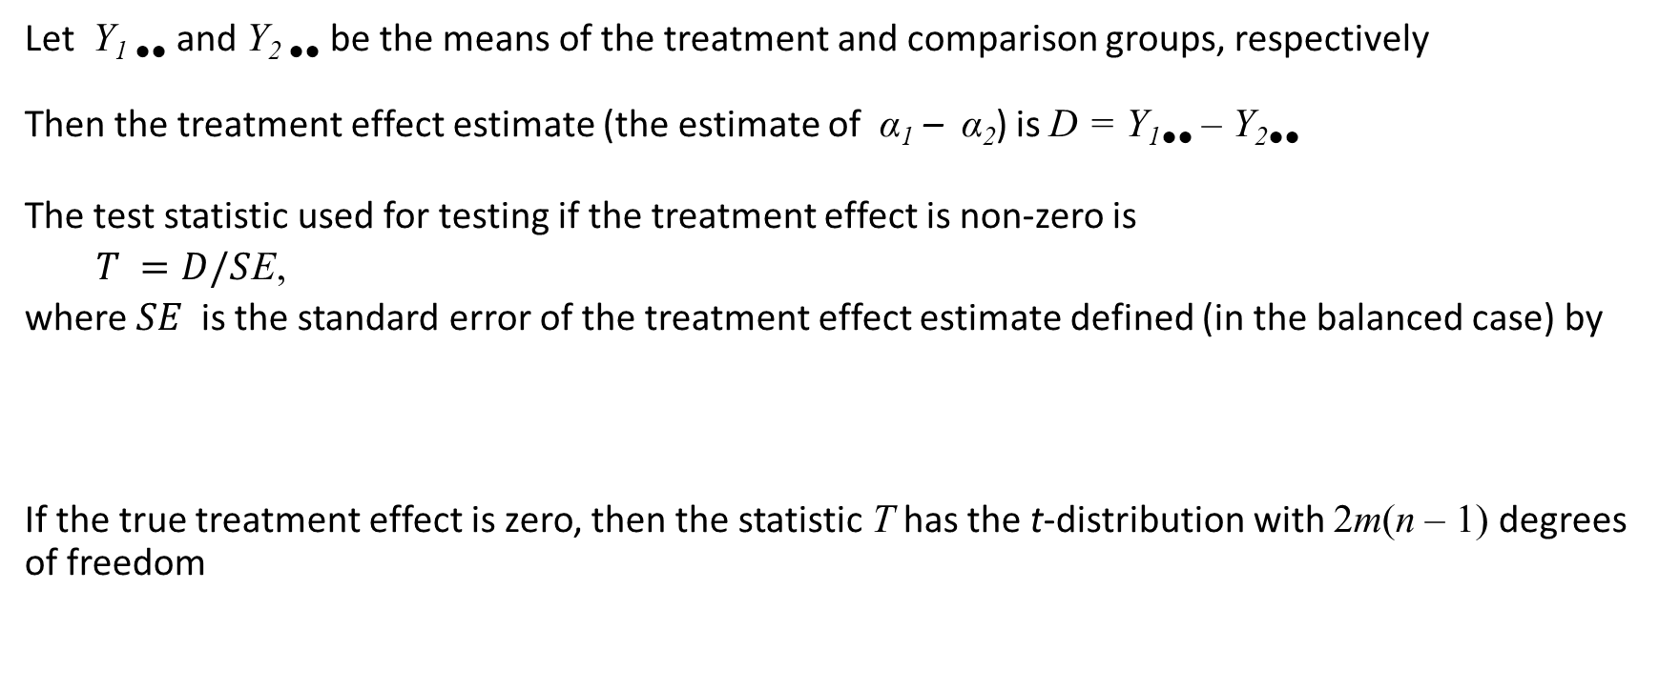
Testing the Significance of the Treatment Effect
Let Y_{1 ●●} and Y_{2 ●●} be the means of the treatment and comparison groups, respectively
Then the treatment effect estimate (the estimate of α₁ – α₂) is D = Y_{1●●} – Y_{2●●}
The test statistic used for testing if the treatment effect is non-zero is
$T =D/S$E,
where $SE$is the standard error of the treatment effect estimate defined (in the balanced case) by
If the true treatment effect is zero, then the statistic T has the t-distribution with 2m(n – 1) degrees of freedom

Slide 11
Testing the Significance of the Treatment Effect
The significance testing process involves
Picking a significance level (this is up to you, but 0.05 is conventional)
Computing the value of T from the data
Obtaining the critical value of the t-distribution with 2m(n – 1) degrees of freedom (which will be about 2 for the for all but the smallest degrees of freedom)
Reject the null hypothesis of no treatment effect (in other words conclude that the treatment effect is significant) if |T| exceeds the critical value
You could also use software that computes the “exact p-value.” In that method, conclude that the treatment effect is significant if the two-tailed p-value is less than 0.05

Slide 12
Design Sensitivity
Recall that design sensitivity can be described in any one of three related ways:
Statistical power: The probability of detecting a given treatment effect size
Precision (standard error) of the estimated treatment effect: The uncertainty (margin of error) of the estimated treatment effect
The minimum detectable effect size (MDES): The smallest effect size that can be detected with a given statistical power
We will primarily use MDES as a tool to plan a design to have adequate sensitivity so that the results of the study will be conclusive

Slide 13
Inference Status of Blocks
The randomized block design introduces a new issue: How do we conceive the sampling of blocks?
This seems like an arcane technical issue, but it boils down to this:
1. Do we want to know what the mean treatment effect is in these (the observed) blocks or
2. Do we wish to know what the mean treatment effect is in a larger population of blocks from which these (the observed) blocks are a random sample?
The second is a much harder inference to make, but it is appropriate in efficacy or effectiveness trials
Most initial field trials, the first (inference about the treatment effect in the observed blocks) is both easier and more appropriate We will assume that this is the objective of your evaluations
Remember: Your goal is probably to show that the treatment can work in some realistic settings, not all settings

Slide 14
MDES in Randomized Block Designs
In randomized block designs, MDES depends on
1. The significance level (0.05 is a very strong convention)
2. The power level desired (0.8 is a strong convention)
The number m of blocks
The number of individuals randomized within blocks
The covariate outcome correlation R is covariates are used
But to a very good approximation, the MDES depends only the total sample size N = 2mn, not m and n individually

Slide 15
Design Sensitivity as a Function of m and n for Fixed N
m | n | N | d | Power | MDES | SE
2 | 100 | 400 | 0.20 | 0.514 | 0.29 | 0.10
4 | 50 | 400 | 0.20 | 0.514 | 0.29 | 0.10
5 | 40 | 400 | 0.20 | 0.514 | 0.29 | 0.10
8 | 25 | 400 | 0.20 | 0.514 | 0.29 | 0.10
10 | 20 | 400 | 0.20 | 0.514 | 0.29 | 0.10
20 | 10 | 400 | 0.20 | 0.514 | 0.29 | 0.10
40 | 5 | 400 | 0.20 | 0.514 | 0.29 | 0.10
100 | 2 | 400 | 0.20 | 0.512 | 0.29 | 0.10

Slide 17
Eric: This might be a good place for a statistical power or MDES insert

Slide 18
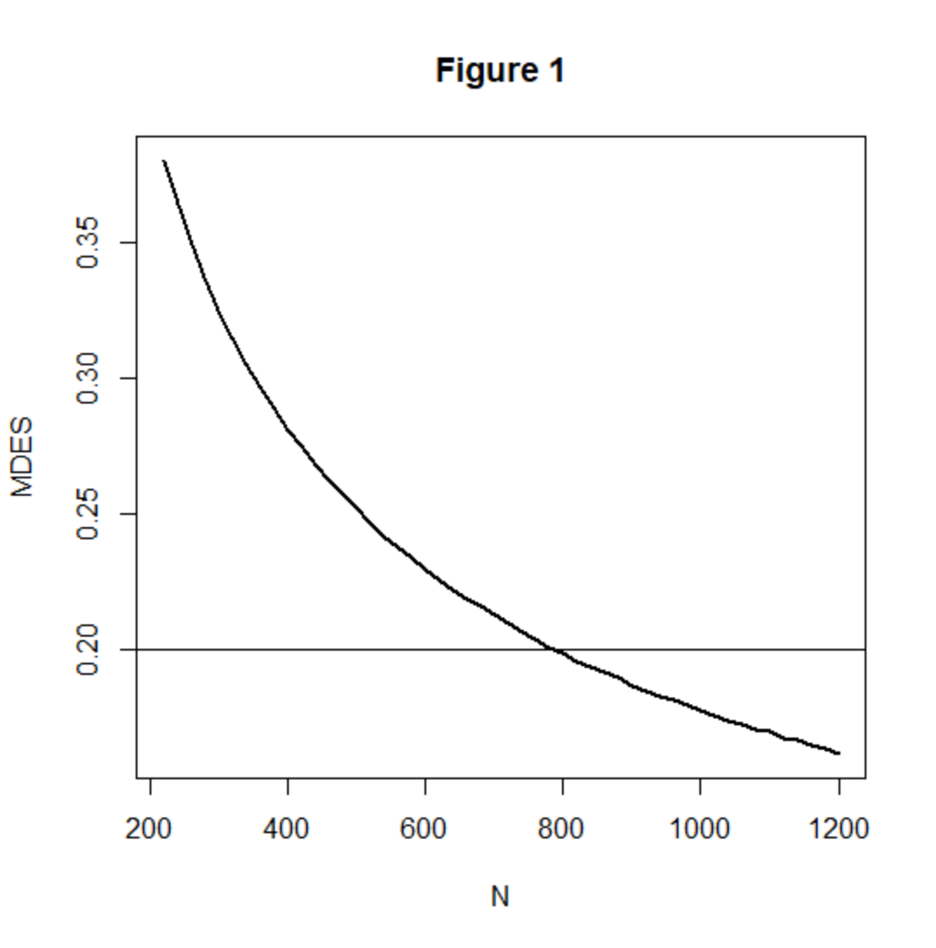
A Graphical Representation of MDES as a Function of N

Slide 19
The Fundamental Problem of Research Design
The fundamental problem of research design is how to plan a feasible design that is adequately sensitive
If you have unlimited sample size, it is easy to get any design sensitivity you want
But we never have access to an unlimited sample size
Especially in development studies, we are usually limited to a small number of schools or classes (10 or less) and at most a total N of few hundred students

Slide 20
How Do You Plan a Research Design?
Start with some notion of the effect size you expect
Then consider what sample of individuals you believe you could get to test the treatment
Are they grouped into schools or classrooms? Can they plausibly be considered independent?
Can they be assigned to treatments individually within schools?
If not, then the individually randomized design cannot be used
In the easiest case, then you simply use a table like the one presented previously or a software tool and find the sample size that has an MDES that is smaller than the effect size you expect
Often, that sample size is larger than the sample you believe you could get
What then?

Slide 21
How Do You Plan a Research Design?
If the balanced design requires a bigger sample size than you believe you can get then:
You can get a bigger sample (it may just be a matter of trying harder)
Change the design (how you do this will depend on what is feasible)
Options for changing the design:
Use a covariate
Consider an unbalanced design

Slide 22
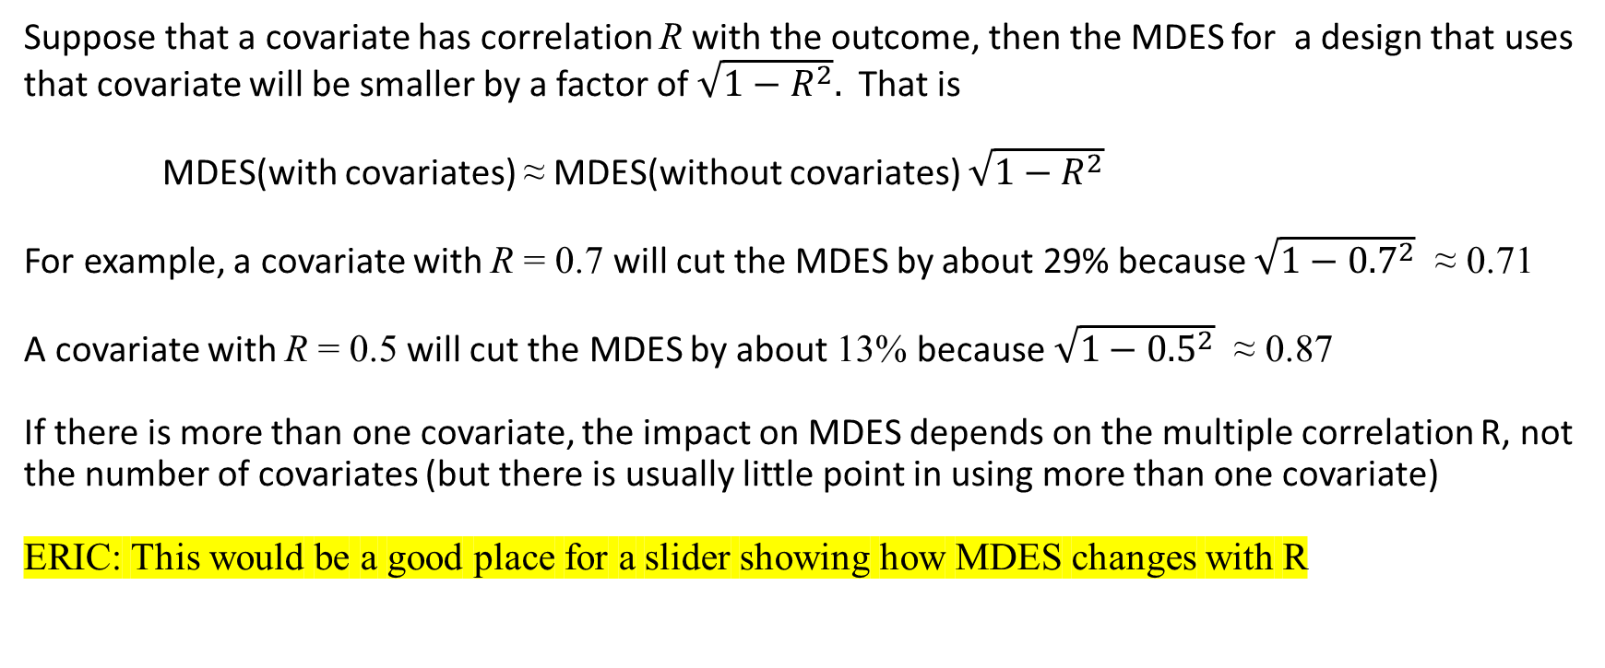
The Effect of Covariates on MDES
Suppose that a covariate has correlation R with the outcome, then the MDES for a design that uses that covariate will be smaller by a factor of $\sqrt{1−R^{2}}.$ That is
MDES(with covariates) ≈ MDES(without covariates) $\sqrt{1−R^{2}}$
For example, a covariate with R = 0.7 will cut the MDES by about 29% because $\sqrt{1−{0.7}^{2}}$ ≈ 0.71
A covariate with R = 0.5 will cut the MDES by about 13% because $\sqrt{1−{0.5}^{2}}$ ≈ 0.87
If there is more than one covariate, the impact on MDES depends on the multiple correlation R, not the number of covariates (but there is usually little point in using more than one covariate)
ERIC: This would be a good place for a slider showing how MDES changes with R

Slide 23
A Tabular Representation of the Influence of R on MDES
N | R=0 | R=0.4 | R=0.6 | R=0.7
220 | 0.38 | 0.36 | 0.34 | 0.32
240 | 0.36 | 0.35 | 0.33 | 0.31
260 | 0.35 | 0.34 | 0.31 | 0.30
280 | 0.34 | 0.32 | 0.30 | 0.29
300 | 0.32 | 0.31 | 0.29 | 0.28
320 | 0.32 | 0.30 | 0.28 | 0.27
340 | 0.30 | 0.29 | 0.27 | 0.26
360 | 0.30 | 0.28 | 0.27 | 0.25
380 | 0.29 | 0.28 | 0.26 | 0.24
400 | 0.28 | 0.27 | 0.25 | 0.24
500 | 0.25 | 0.24 | 0.23 | 0.21
800 | 0.20 | 0.19 | 0.18 | 0.17
1000 | 0.18 | 0.17 | 0.16 | 0.15
1200 | 0.16 | 0.16 | 0.15 | 0.14

Slide 24
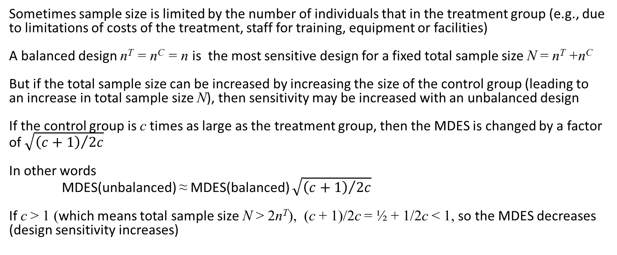
Unbalanced Designs
Sometimes sample size is limited by the number of individuals that in the treatment group (e.g., due to limitations of costs of the treatment, staff for training, equipment or facilities)
A balanced design n^{T} = n^{C} = n is the most sensitive design for a fixed total sample size N = n^{T} +n^{C}
But if the total sample size can be increased by increasing the size of the control group (leading to an increase in total sample size N), then sensitivity may be increased with an unbalanced design
If the control group is c times as large as the treatment group, then the MDES is changed by a factor of $\sqrt{{\left(c+1\right)}/{2c}}$
In other words
MDES(unbalanced) ≈ MDES(balanced) $\sqrt{{\left(c+1\right)}/{2c}}$
If c > 1 (which means total sample size N > 2n^{T}), (c + 1)/2c = ½ + 1/2c < 1, so the MDES decreases (design sensitivity increases)

Slide 25
Unbalanced Designs
Eric: This would be a good place for an insert of how increasing n^{C} (fixing n^{T}) deceases MDES
Note that the effect on MDES (design sensitivity) of increasing sample size of the control group are generally modest (except for the smallest treatment group sample sizes
Note that there is a point of diminishing returns, beyond which further increases have only negligible effects

Slide 26
A Tabular Representation of the Influence of Unbalanced Designs on MDES
 | π = 0.5 |  |  | π = 0.4 |  |  | π = 0.3 |  |  | π = 0.2 |  |  | π = 0.1
n^{T} | N | MDES |  | N | MDES |  | N | MDES |  | N | MDES |  | N | MDES
100 | 200 | 0.40 |  | 250 | 0.36 |  | 333 | 0.34 |  | 500 | 0.31 |  | 1000 | 0.30
150 | 300 | 0.32 |  | 375 | 0.30 |  | 500 | 0.27 |  | 750 | 0.26 |  | 1500 | 0.24
200 | 400 | 0.28 |  | 500 | 0.26 |  | 667 | 0.24 |  | 1000 | 0.22 |  | 2000 | 0.21
250 | 500 | 0.25 |  | 625 | 0.23 |  | 833 | 0.21 |  | 1250 | 0.20 |  | 2500 | 0.19
300 | 600 | 0.23 |  | 750 | 0.21 |  | 1000 | 0.19 |  | 1500 | 0.18 |  | 3000 | 0.17
350 | 700 | 0.21 |  | 875 | 0.19 |  | 1167 | 0.18 |  | 1750 | 0.17 |  | 3500 | 0.16
400 | 800 | 0.20 |  | 1000 | 0.18 |  | 1333 | 0.17 |  | 2000 | 0.16 |  | 4000 | 0.15
500 | 1000 | 0.18 |  | 1250 | 0.16 |  | 1667 | 0.15 |  | 2500 | 0.14 |  | 5000 | 0.13
600 | 1200 | 0.16 |  | 1500 | 0.15 |  | 2000 | 0.14 |  | 3000 | 0.13 |  | 6000 | 0.12

Slide 27
Eric: This could be a good place for a demo of both unbalance and covariates on MDES

